Slide 2
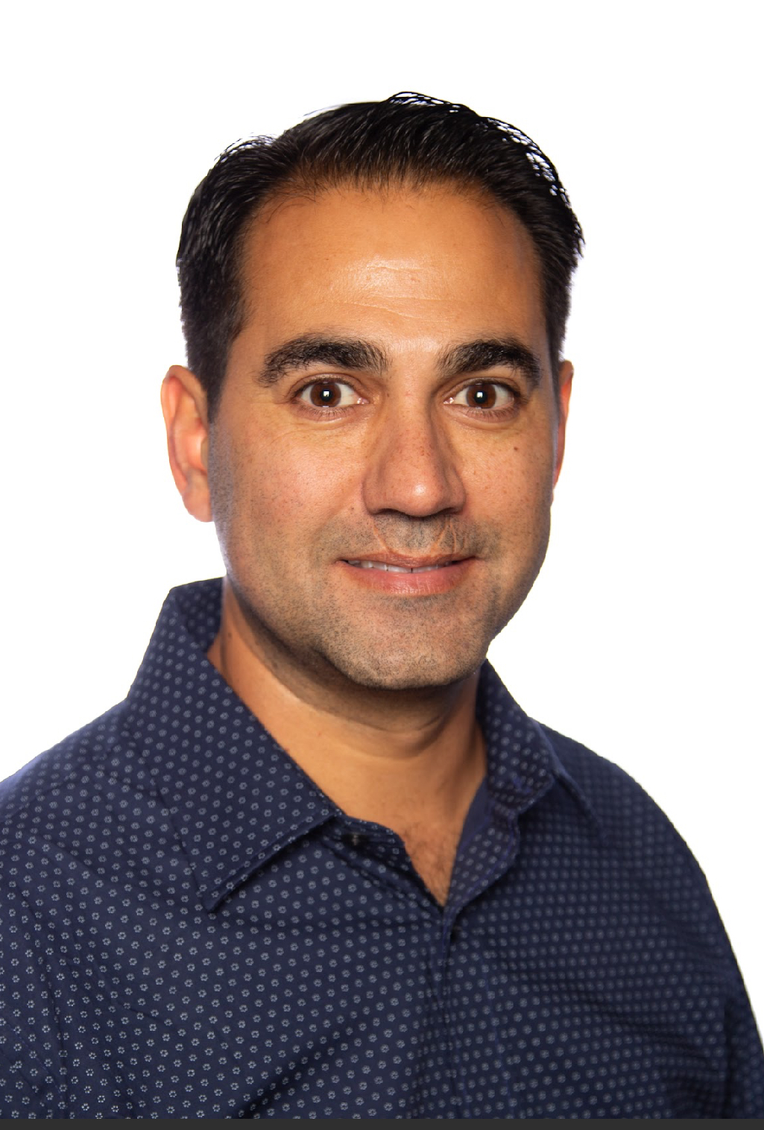
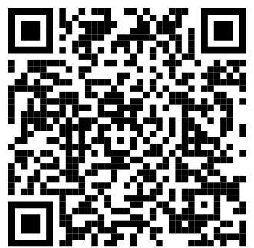
Justin Sider Chief Information Officer Belay Technologies
Invoke-VCF –Version 9 InstallType Full –Confirm:$false

Slide 3
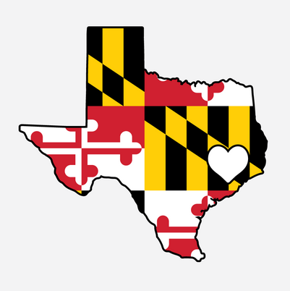
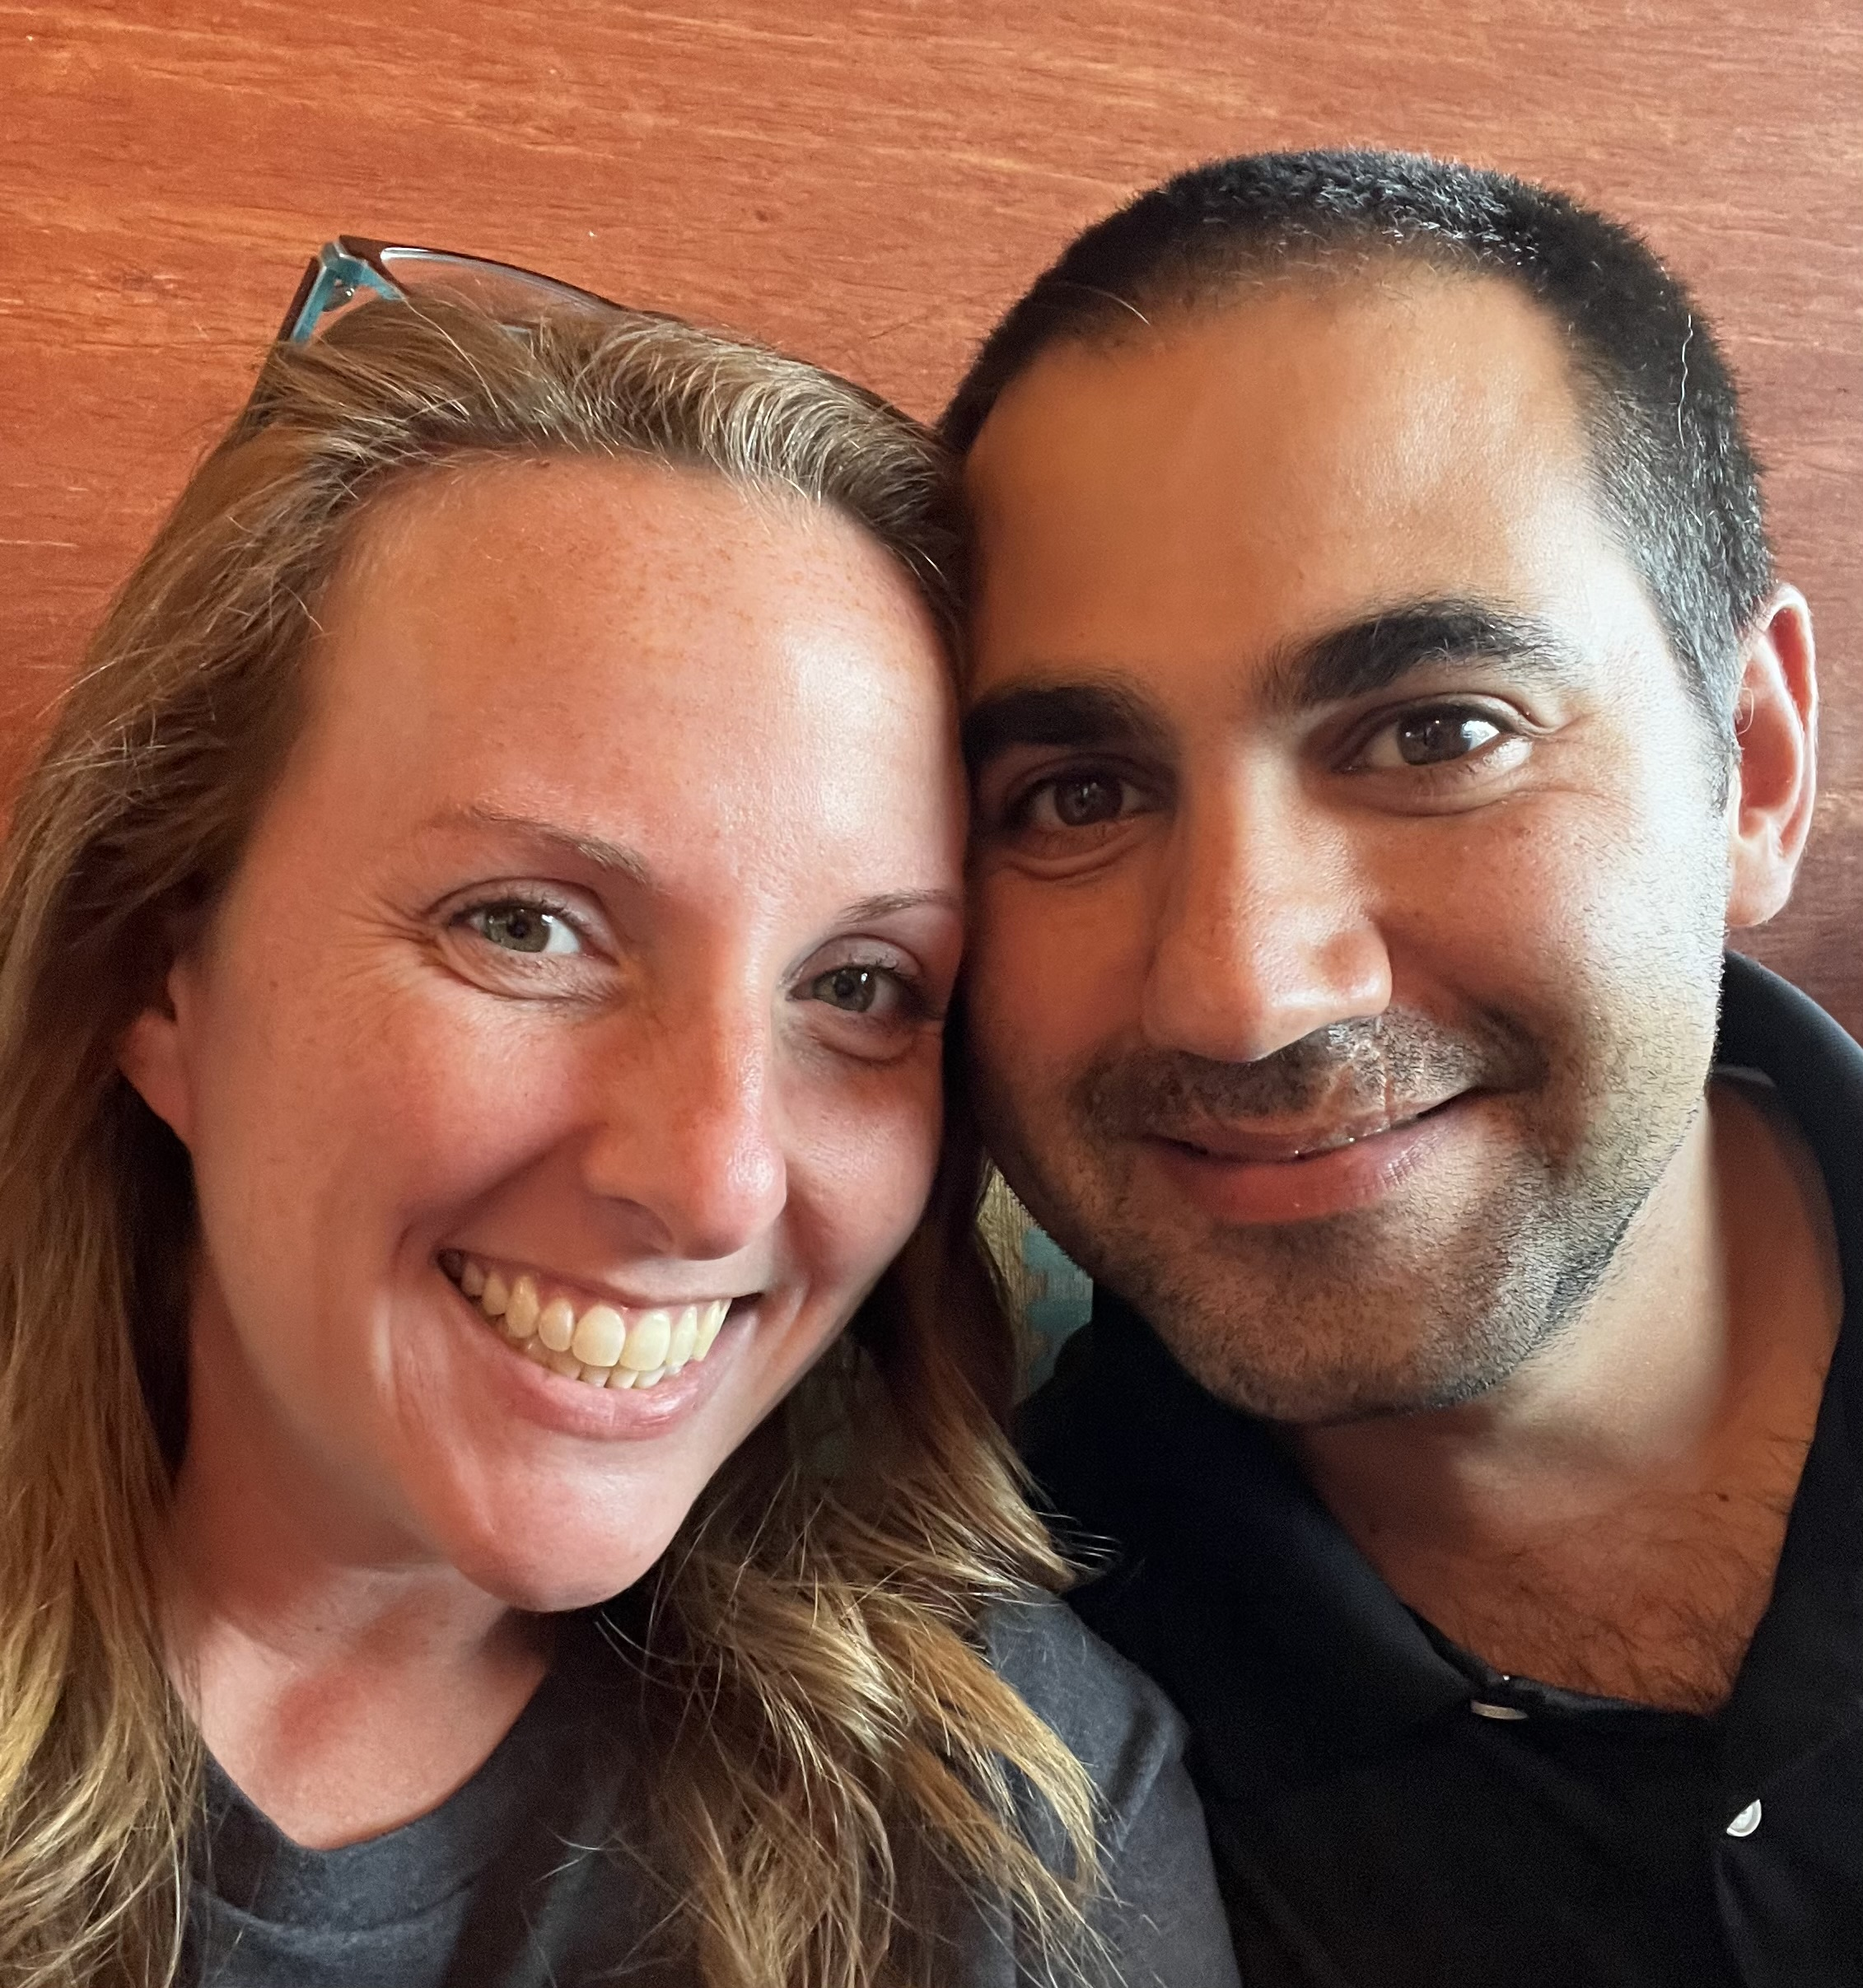
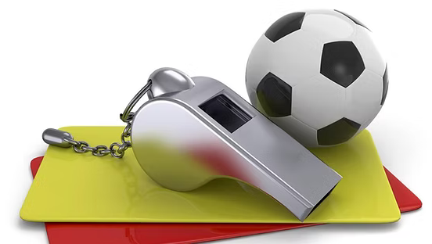
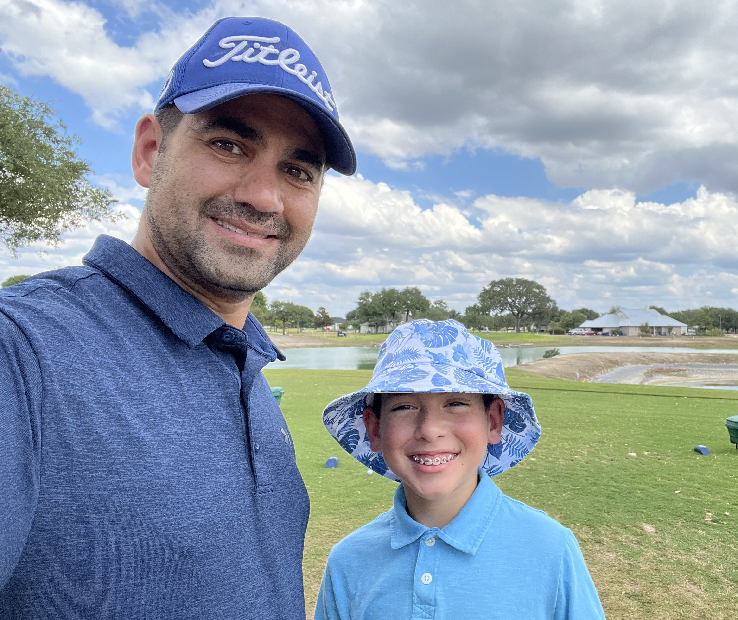
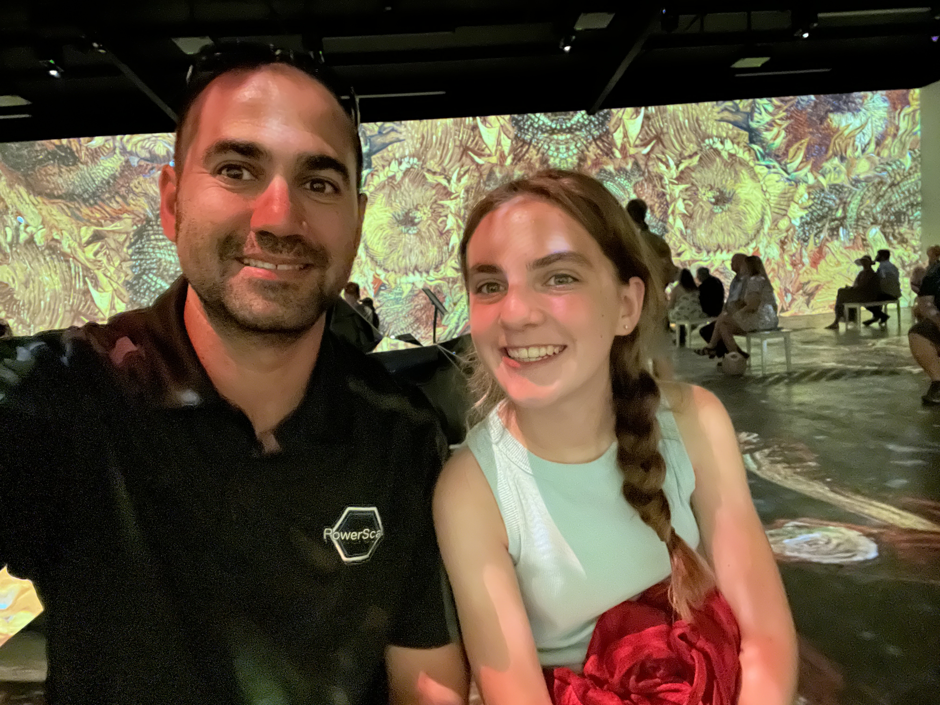
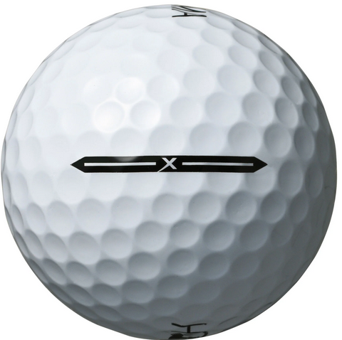
About me
Blog
Invoke-automation.blog
Twitter(X)/Slack/GitHub
jpsider
VMware Programs
VMUG Advantage
VMUG Board of Directors
vExpert x10
VMware {Code} Coach
PowerShell Developer

Slide 4
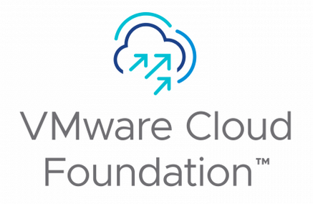

Agenda
About Belay’s Workloads
Current Deployment
Future Deployment (VCF)
VCF Considerations

Slide 5

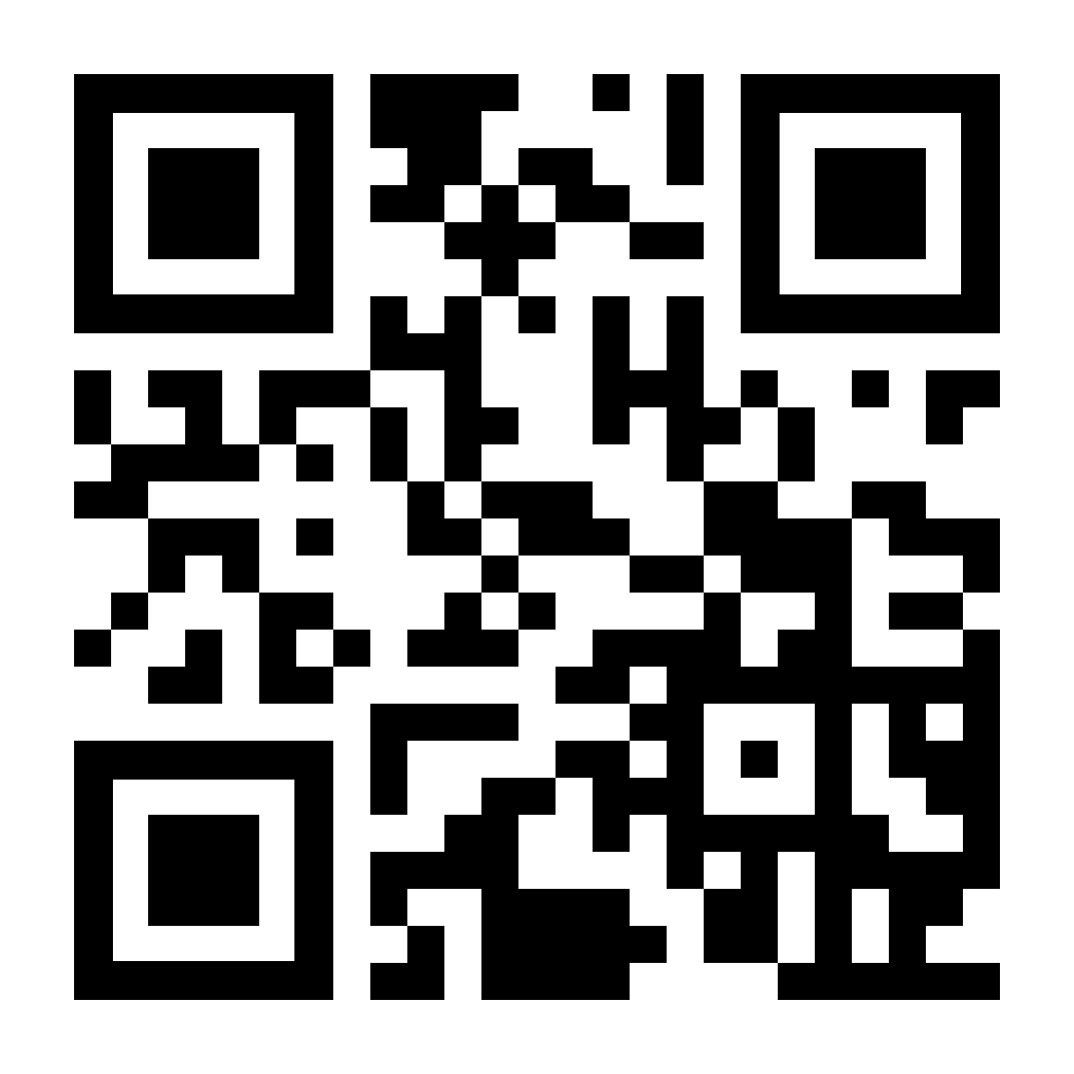
Belay’s Workloads
Automated Range Testing
Provisioning Engine
Task Execution Engine
Think along the lines of VMware Hands on Labs
Other use cases
Security Patch testing
Integration testing
Range testing
SummitRTS.com

Slide 6
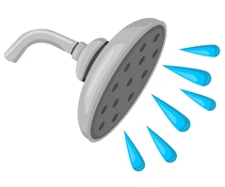

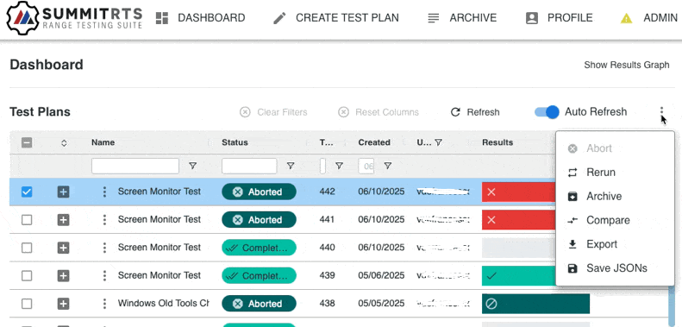

General Workflow
Provision Environment
Run User Scenario(s)
Collect & Return Results

Slide 7

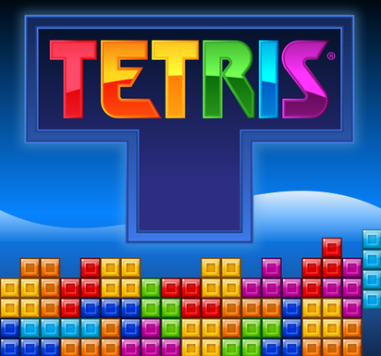
Challenges
Scalability
Identify and remove choke points
Efficiency
Use maximum compute at all times
Security
Separate customer workloads
Limit access to Test Plan results
Throughput
Get users their results as fast as possible

Slide 8
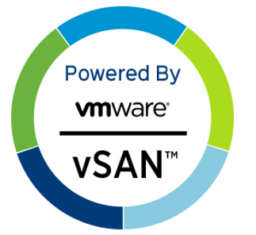
Current Deployment
VMware Products
vCenter
ESXi
NSX
LogInsight
Kubernetes
Rancher
Lots of PowerShell
Automation & Monitoring
Lots of Python
Automation & Monitoring
Other Stuff
Single Namespace per Test Range (our software)
Each Test Range has its own NSX Domain
Assign a test range per customer
Or allow them to share based on SLA’s
No vSan
Storage is NFS & iSCSI
Commodity Hardware

Slide 9
Current Deployment Considerations
Physical Separation of Infrastructure and Test Range
Security Boundaries
Upgrades - Our software & 3rd party
Multiple NSX Domains
Infrastructure
Test Range
Multiple Test Ranges (VMware Limitations)
Prod, Pre-Prod, Integration
Hardware Refresh
Managing the Blast Radius
Hardware failure or security boundary

Slide 10



Current Architecture
P or V
Management Cluster
NSX Management Cluster
Test Range
Logs
Logs, Test Artifacts

Slide 11
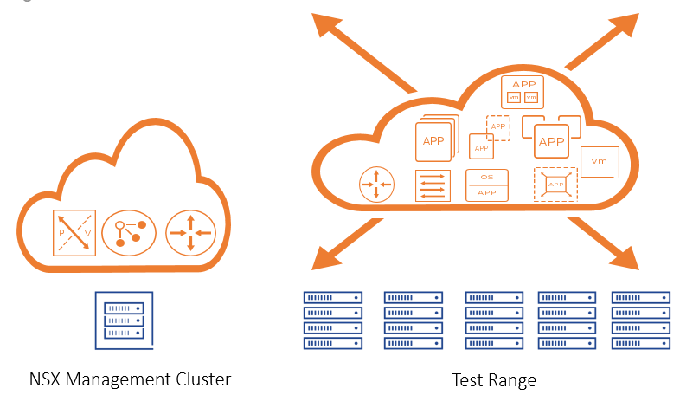
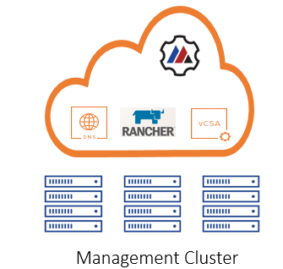
Current Architecture
Dev
tr6
tr1
tr5
Production, Customer Z
Pre-Prod
tr2
tr4
tr3
Production, Customer Y
Production, Customer X
Integration

Slide 12
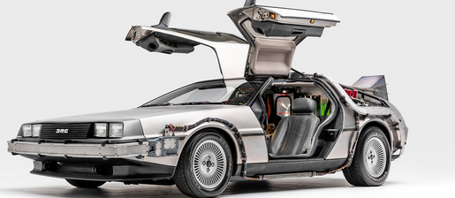
What does the future look like for Belay?

Slide 13
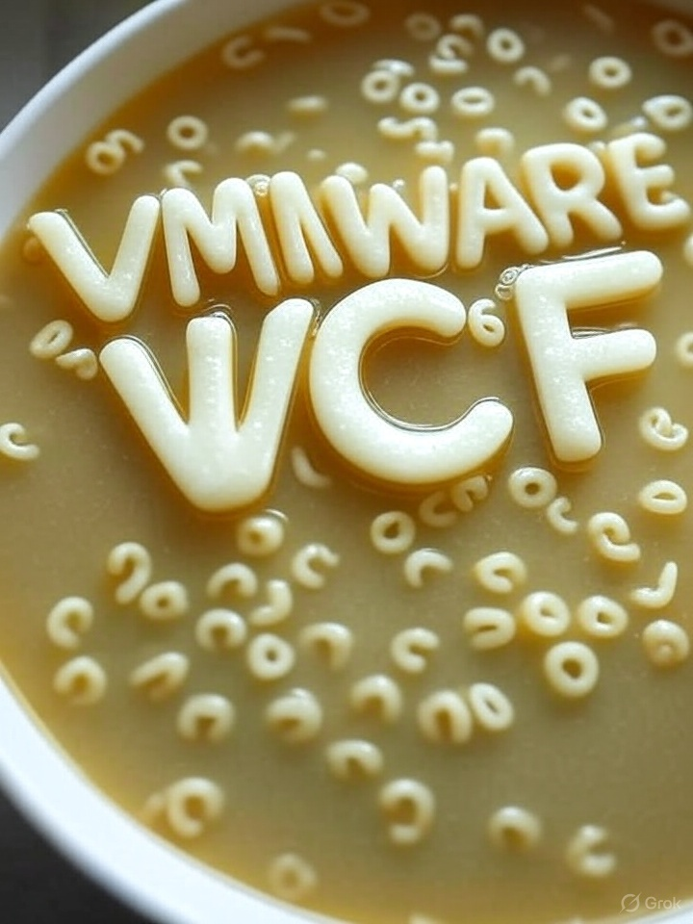
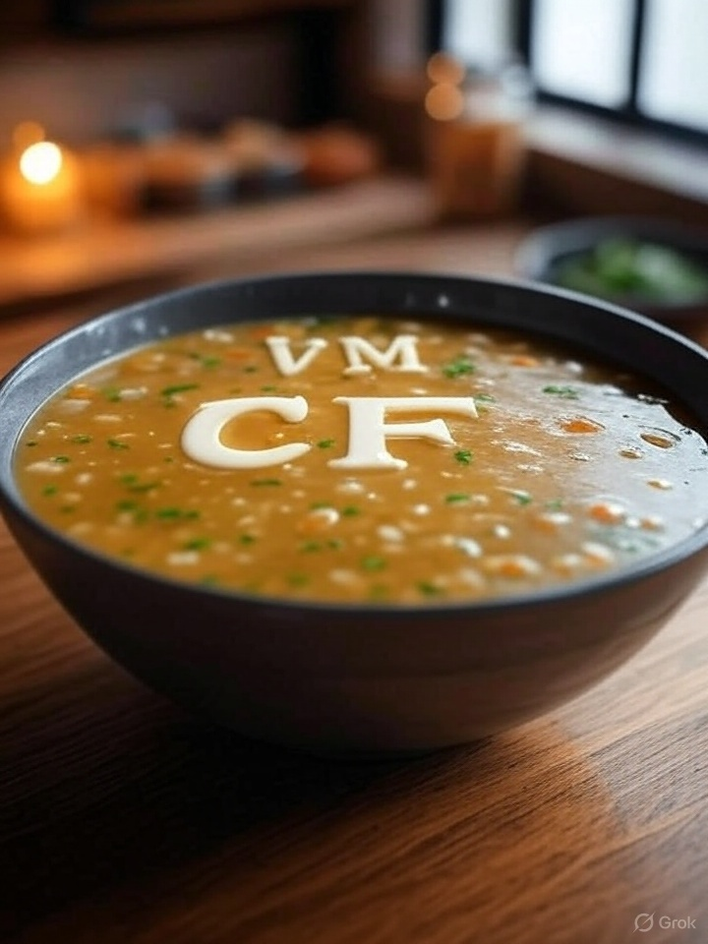
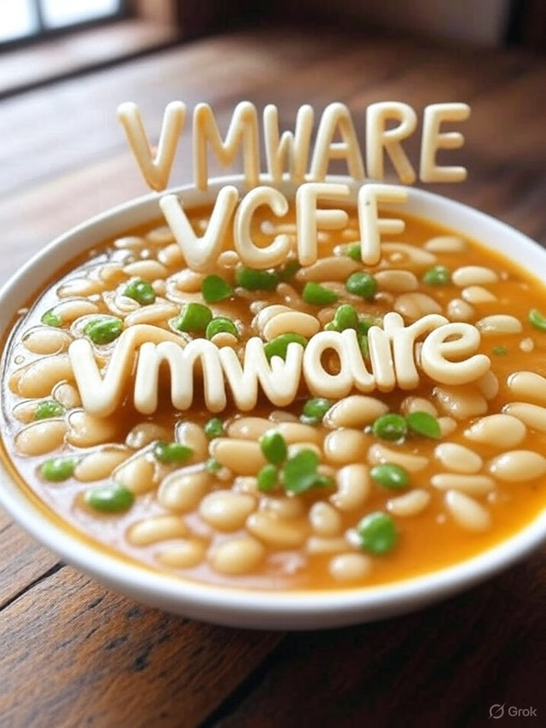
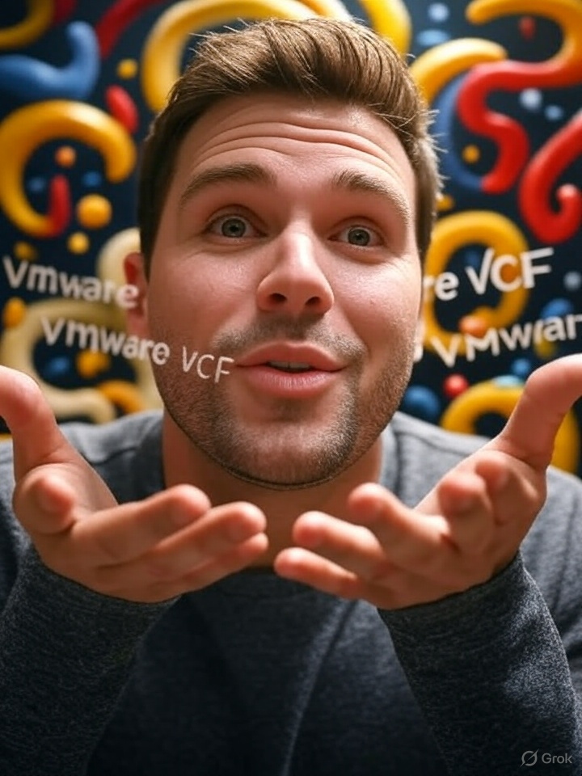
Alphabet Soup (Grok)
2. create an image with VMware VCF text that looks like alphabet soup
1. create an image with VMware VCF words that looks like alphabet soup
3. Justin Sider shrugging

Slide 14
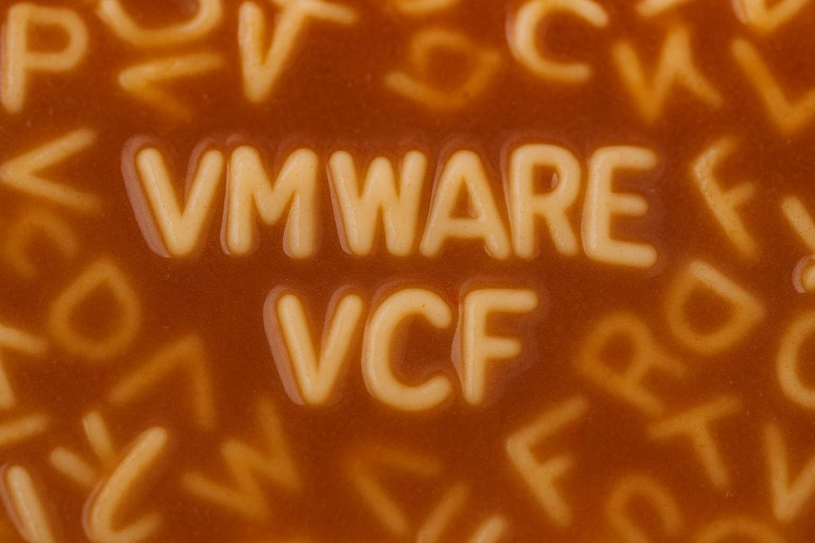
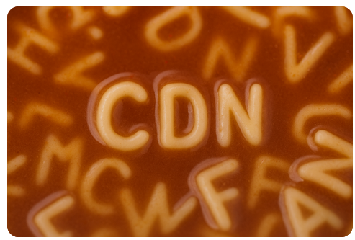

Alphabet Soup (ChatGPT)
2. create an image with VMware VCF text that looks like alphabet soup
1. create an image with VMware VCF words that looks like alphabet soup
3. Justin Sider shrugging

Slide 15
VCF Deployment
VMware Products
vCenter
ESXi
NSX
SDDC Manager
vSphere Kubernetes Service
VCF Operations for logs
LogInsight
VCF Operations Orchestrator
VCF Operations for networks
Other Stuff
Single Namespace per Test Range (our software)
Each Test Range has its own NSX Domain
Assign a test range per customer
Or allow them to share based on SLA’s
No vSan
Storage is NFS & iSCSI
Commodity Hardware

Slide 16

VCF Deployment(s)
Management Domain
Workload Domain
All the Management Things
All test range things
Logs, Test Artifacts

Slide 17
VCF Considerations
Physical/Virtual Requirements
Component | vCPUs | Memory
SDDC Manager | 4 | 16 GB
vCenter Server (Mgmt) | 4 | 19 GB
NSX Manager Cluster (Mgmt) | 24 | 72 GB
NSX Edge Node Cluster (Mgmt) | 8 | 16 GB
vCenter Server (VI WLD) | 8 | 28 GB
NSX Manager Cluster (VI WLD) | 48 | 144 GB
VCF Operations (Total) | 116 | 332 GB
Supervisor Cluster | 24 | 96gb
Workload Cluster | 28 | 72 gb
Total | 264 | 795 GB
This does not include Workload domain resources!

Slide 18
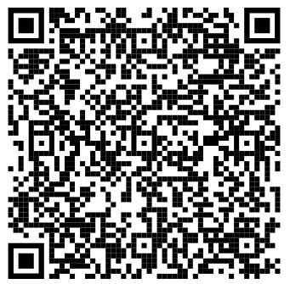
VCF Considerations
VCF vs. VVF
NSX
VCF Operations
VCF Automation
Storage
vSan
External Storage
VCF 9.0 Bill of Materials
https://techdocs.broadcom.com/us/en/vmware-cis/vcf/vcf-9-0-and-later/9-0/release-notes/vmware-cloud-foundation-90-release-notes/vmware-cloud-foundation-bill-of-materials.html

Slide 19
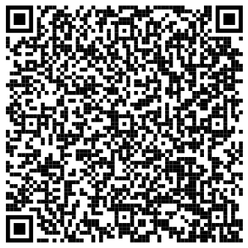
vSphere Supervisor and Kubernetes Service
Upstream Kubernetes Clusters
We are still investigating how this would impact our current deployment of Rancher on VMware
There is a lot to unpack in the Tanzu realm
https://techdocs.broadcom.com/us/en/vmware-cis/vcf/vcf-9-0-and-later/9-0/vsphere-supervisor-installation-and-configuration/vsphere-supervisor-concepts/vsphere-iaas-control-plane-concepts/what-is-vsphere-with-tanzu.html

Slide 20
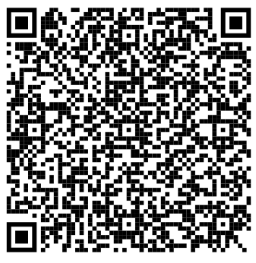
VCF Operations Orchestrator
Automate Common Management Tasks
Workflow management
More Admin-focused vs. end user
https://techdocs.broadcom.com/us/en/vmware-cis/vsphere/vsphere/9-0/vcenter-and-host-management/automating-management-tasks-with-vco-host-management/concepts-of-workflows-host-management.html

Slide 21
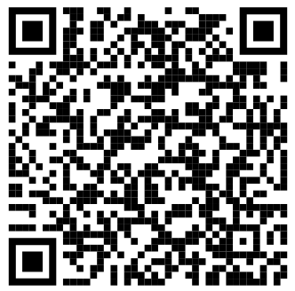
VCF Operations for Networks
Application Visibility
Application Discovery
Guided Troubleshooting
Network Mapping
Assurance for the Security team
Search capabilities
https://www.vmware.com/products/cloud-infrastructure/vcf-operations-for-networks#features

Slide 22
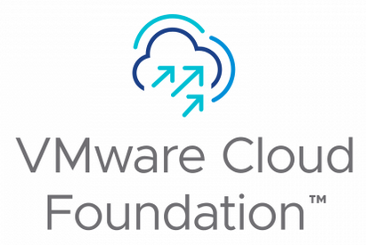
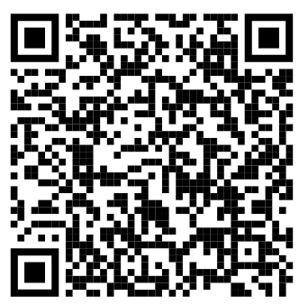
VCF Operations Fleet Management
Lifecycle
Certificates
Passwords
Licensing
SSO
+
https://www.velements.net/2025/03/11/vcf-operations-fleet-management-what-you-need-to-know/

Slide 23
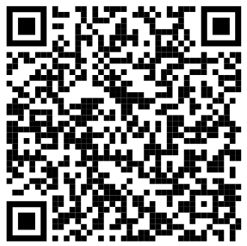
VCF Automation
Self-Service Experience
Development resources
Simplify our Testing Platform
Already plumbed for VMware
Content Mgmt
Governance & Security
https://blogs.vmware.com/cloud-foundation/2025/06/17/unified-cloud-consumption-experience-with-vcf-9-0/

Slide 24
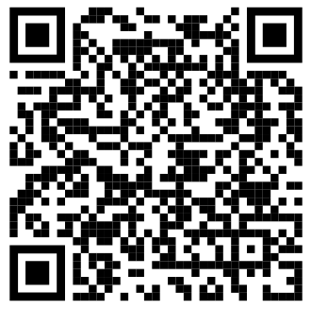
VCF Private AI
Build Tests
Analyze Results
Per Customer
Troubleshoot Failed Tests
(need more hardware!)
https://www.vmware.com/solutions/cloud-infrastructure/private-ai

Slide 25
Thank you!
https://github.com/jpsider/Invoke-Automation/tree/master/VMUG/GVE_June_2025

